Slide 1


Rockbuster Data Dictionary
By Chris Arnold

Slide 2
Table of Contents
Table of contents P2
Entity relationship diagram P3
Fact table P4
Rental P4
Dimension Tables P5
Payment P5
Store P6
Film_actor P7
Inventory P7
Film_category P7
Customer P8
Staff P8
Actor P9
Film P9
Category P10
Address P10
Language P10
City P11
Country P11

Slide 3
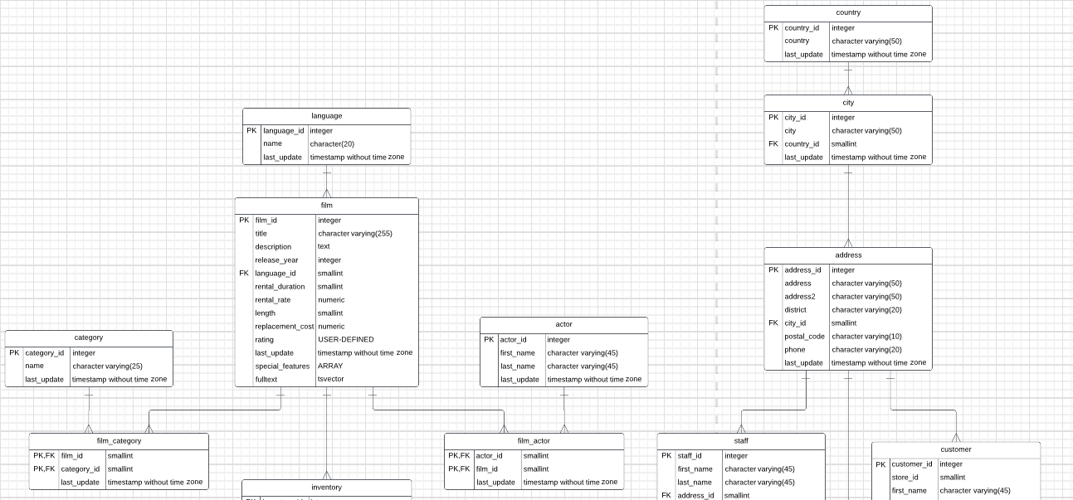
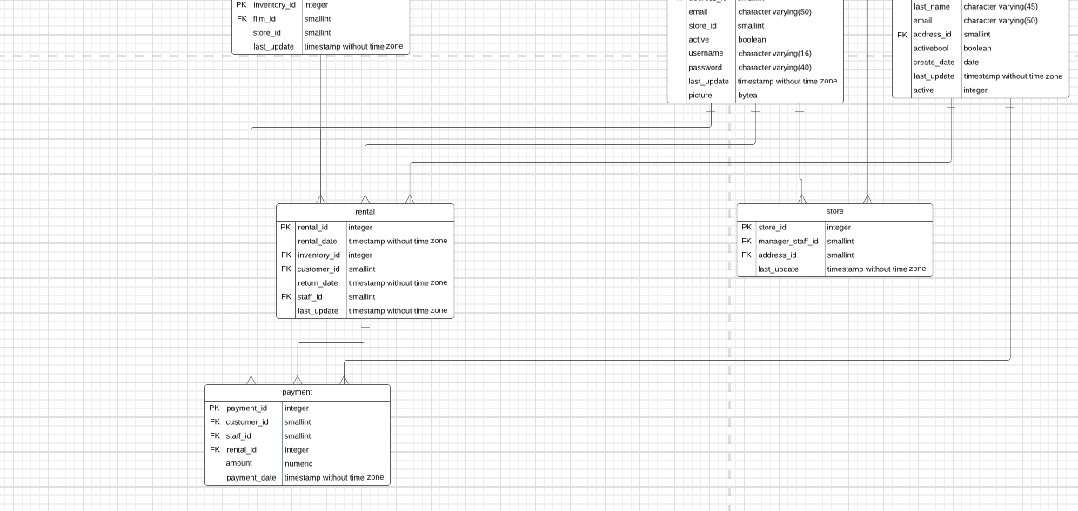
Entity Relationship Diagram

Slide 4
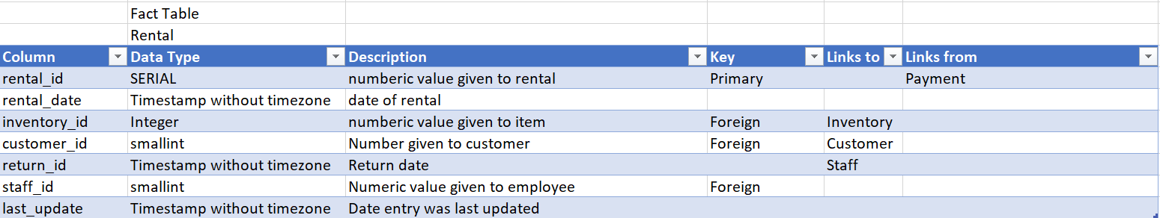

Slide 5
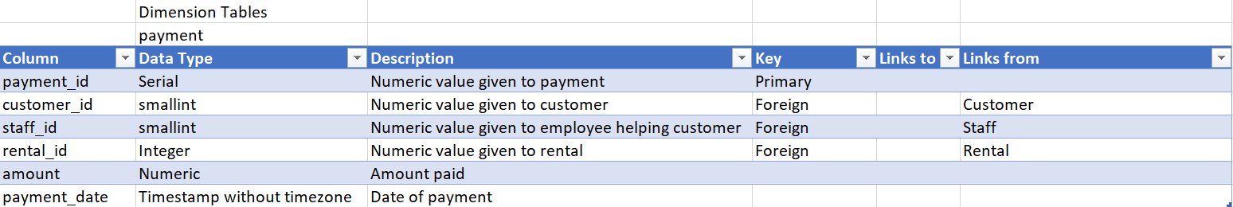

Slide 6
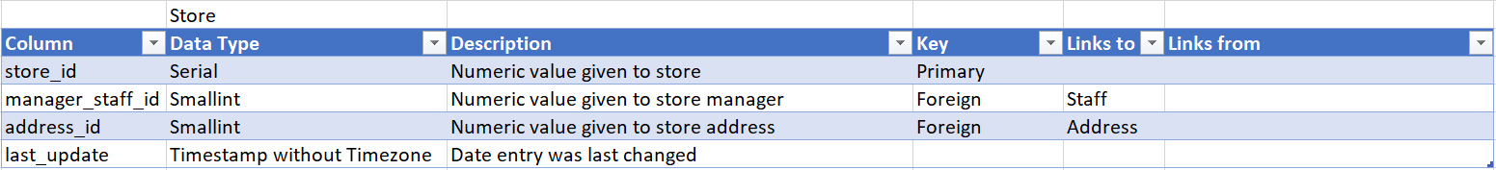

Slide 7
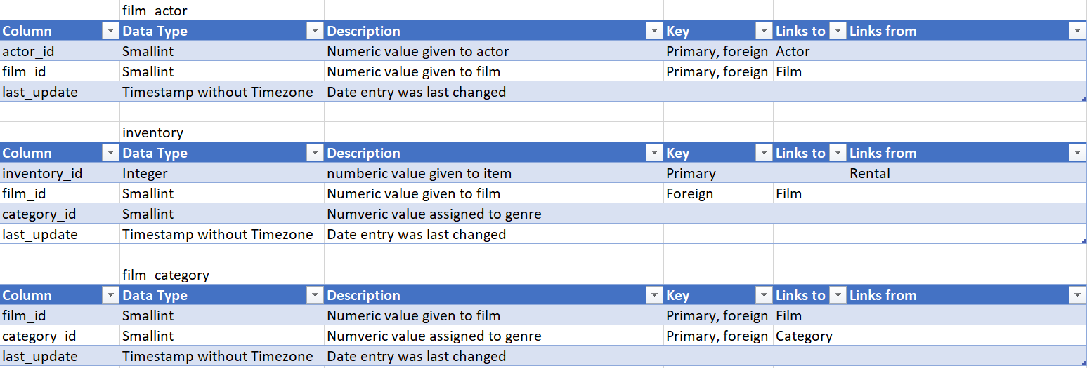

Slide 8
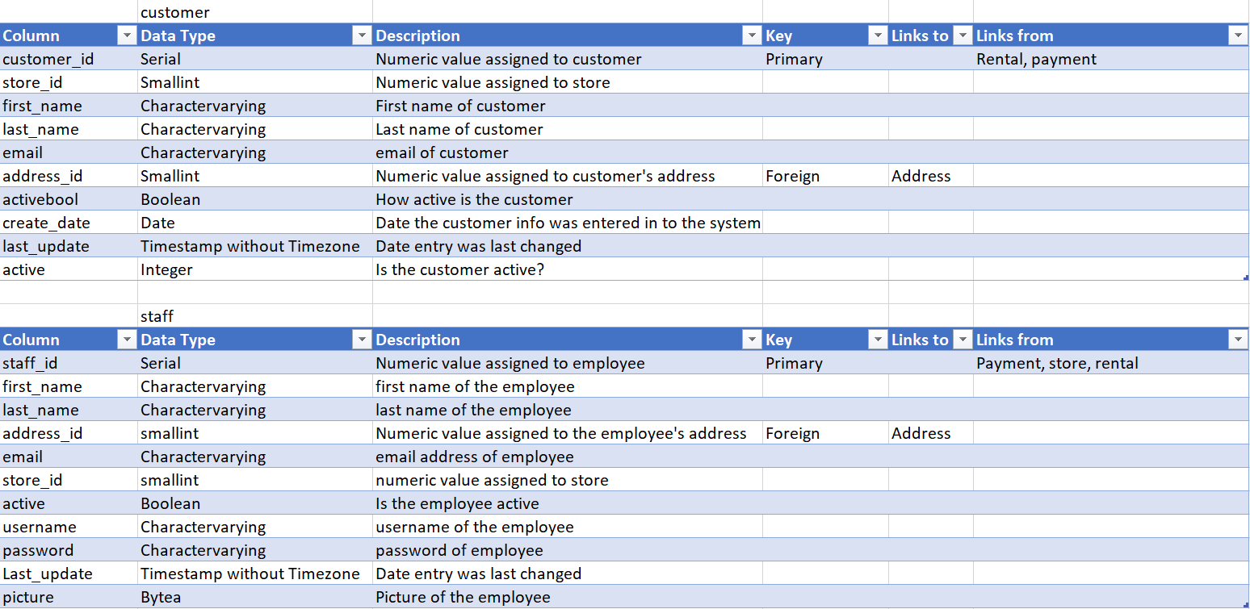

Slide 9
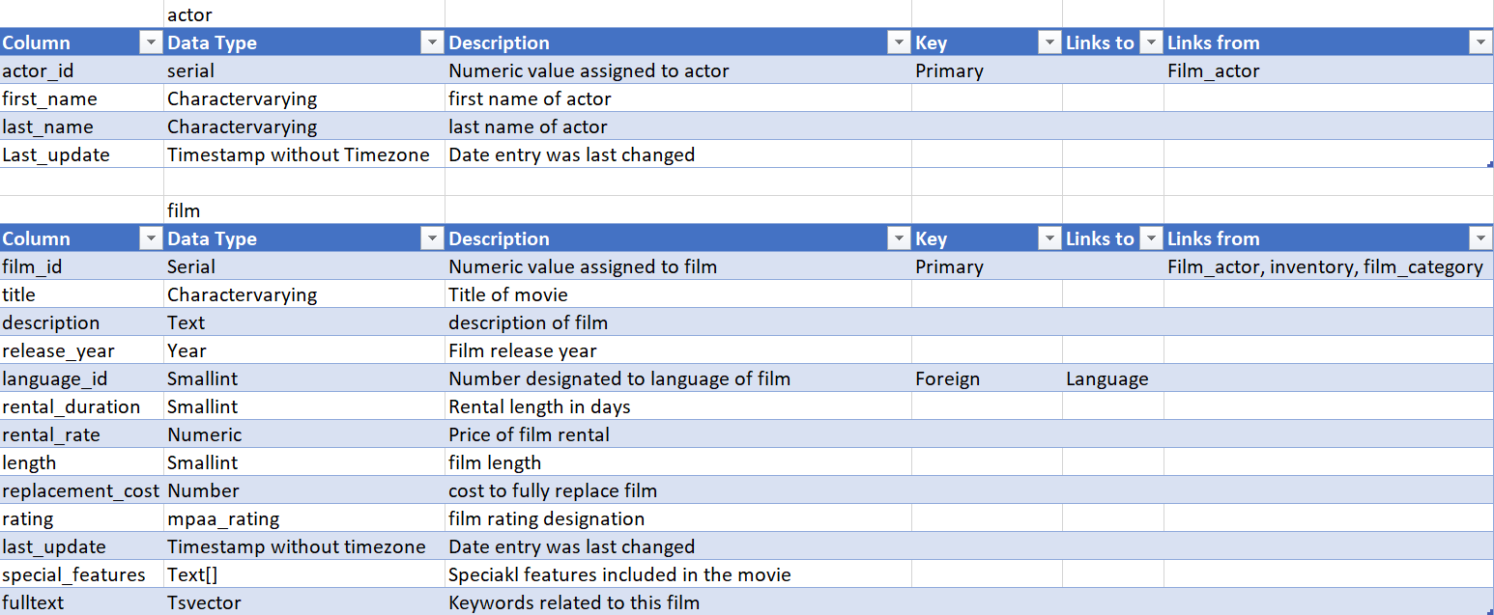

Slide 10
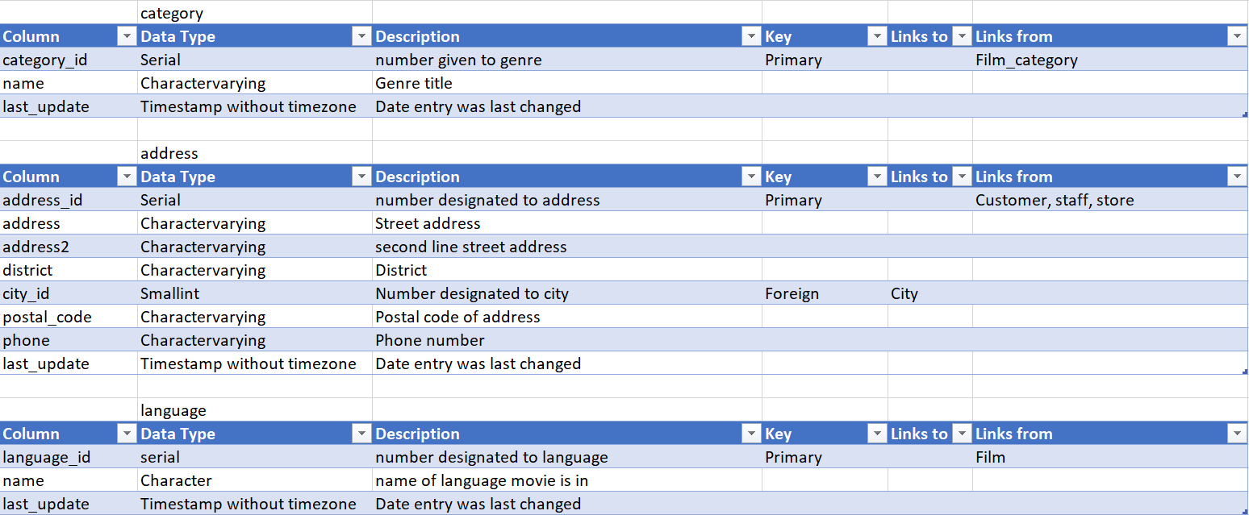

Slide 11
